Slide 1
Python Course for Physicists (And everyone else!) Chunk 10: 2D numpy and mpl
By Jonathan Bollig
09.10.2025

Slide 2
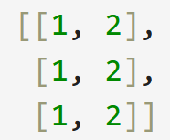
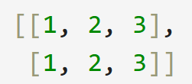


Nested Numpy Arrays:
Possible, if we have a homogenous shape: → All “sub-lists” have the same length → 1D is a vector, 2D is a Matrix, etc.
Arbitrary dimensions possible → shape: dimensions & lengths
✅
❌

Slide 3
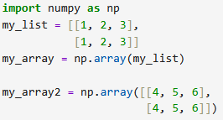
Live Coding: Creating nD Numpy Arrays
Via List:
Via functions:
np.zeros(shape) / np.ones(shape): Array filled with 0 / 1 of shape “shape”.
np.full(n, what): Array of shape “shape”, filled with “what“

Slide 4
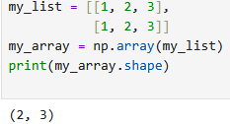
The Shape
Shape is a tuple, indicating the length of every dimension / axis
Array:
Shape: (2, 3) (3, 2) (2, 2 , 2)
Shape can be obtained by printing

Slide 5
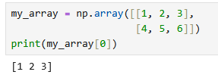

Live Coding: Indexing
Same as before, but dimensions can be separated by coma:
Absence of coma indicates first dimension:
With a coma, the next dimension is accessed:

Slide 6
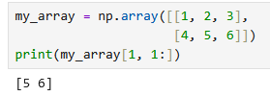
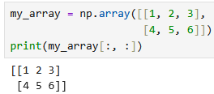
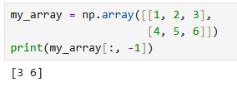
Live Coding: Slicing
Slicing: Still used to select a range: Here: First index selects 2. row. Second index selects last 2 elements
Passing no numbers before and after “:” returns everything:
How to extract [3, 6]? Select all rows and the last column:

Slide 7
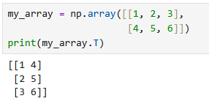

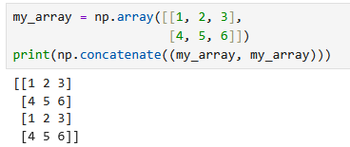
Live Coding: Useful Functions
Transpose: .T
Flatten: .flatten()
Concatenate: np.concatenate((tuple of arrays))
A ton more functions can be found here.

Slide 8
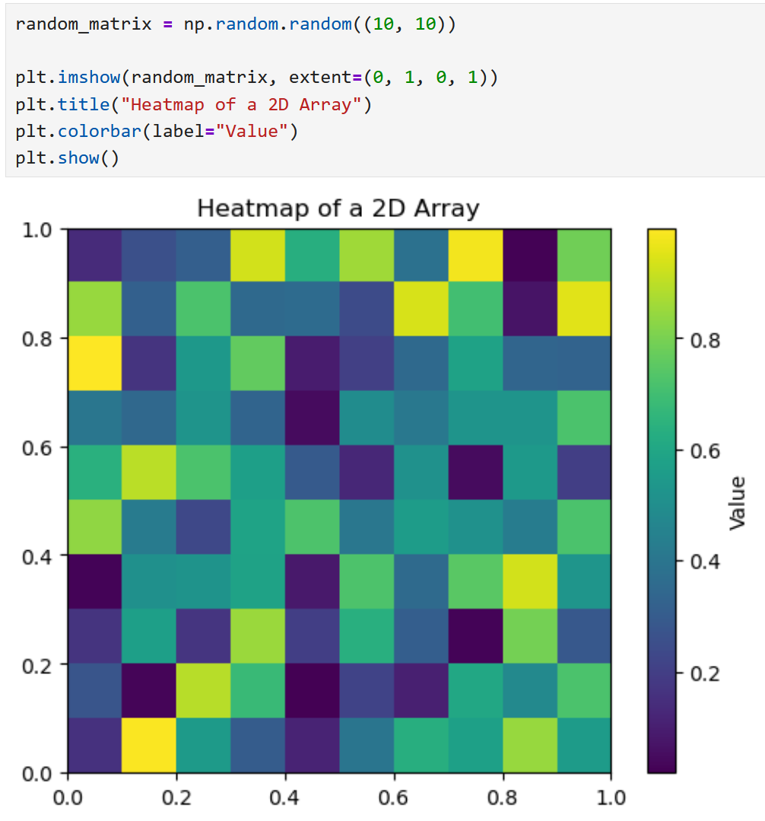
Live Coding: 2D – Plots
imshow() plots an image of a 2D array:
The color of a pixel represents the value.
The optional argument “extent” takes a tuple (x_min, x_max, y_min, y_max) the defines the x and y-scale. Default are pixel.
colorbar() adds the scale on the side.

Slide 9
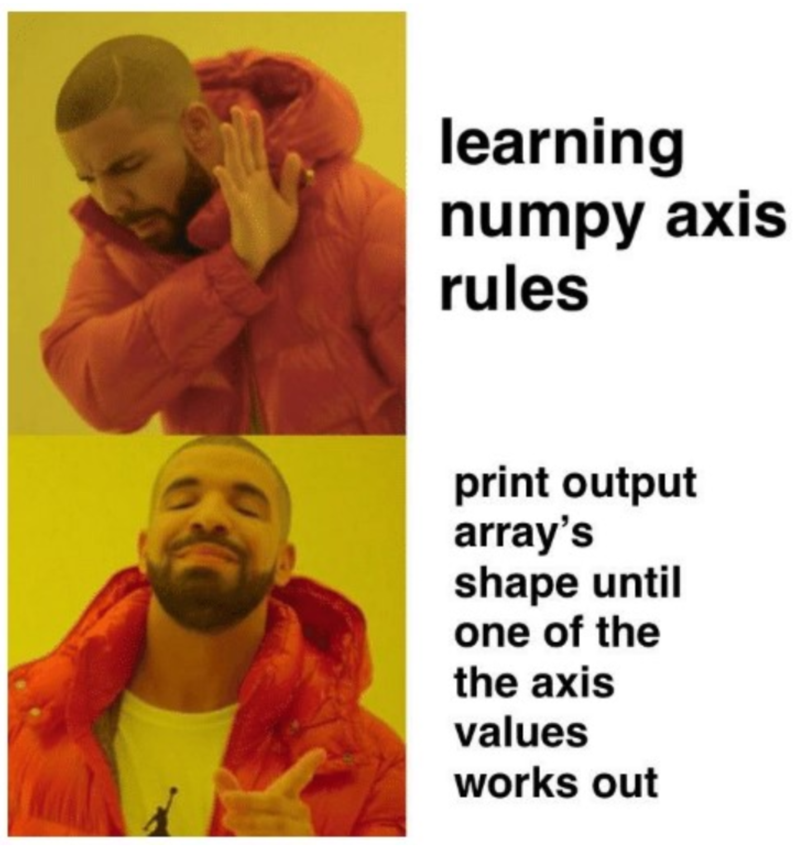
Good Luck with your Tasks ☺
[https://andrewm4894.com/2020/10/15/numpy-feature-engineering-2x-speed-up-over-pandas/]

